Slide 1
JAVASCRIPT

Slide 3
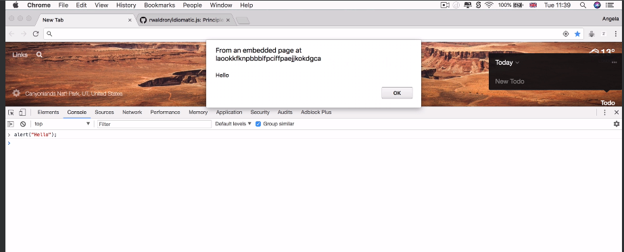
Writing javascript in browser console

Slide 4

Use shift+enter to go to next line in browser console
Alternative is sources >> snippets >> new snippets

Slide 5
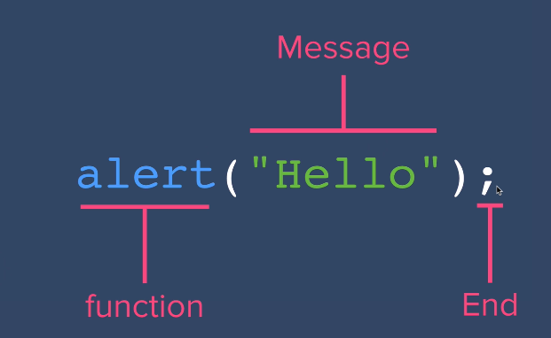

Slide 6
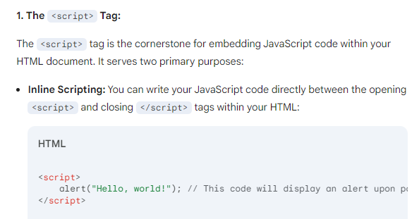
Adding JS to html

Slide 7
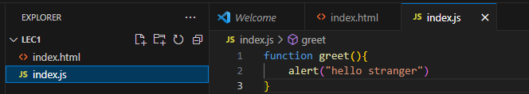
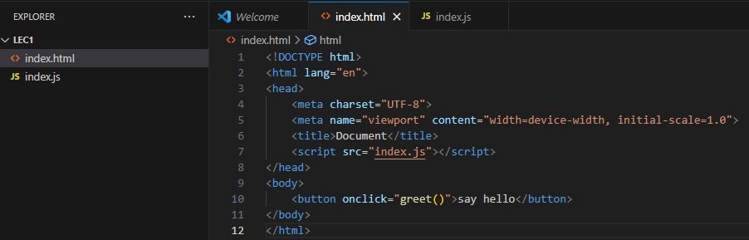

Slide 8
JAVASCRIPT VARIABLES

Slide 9
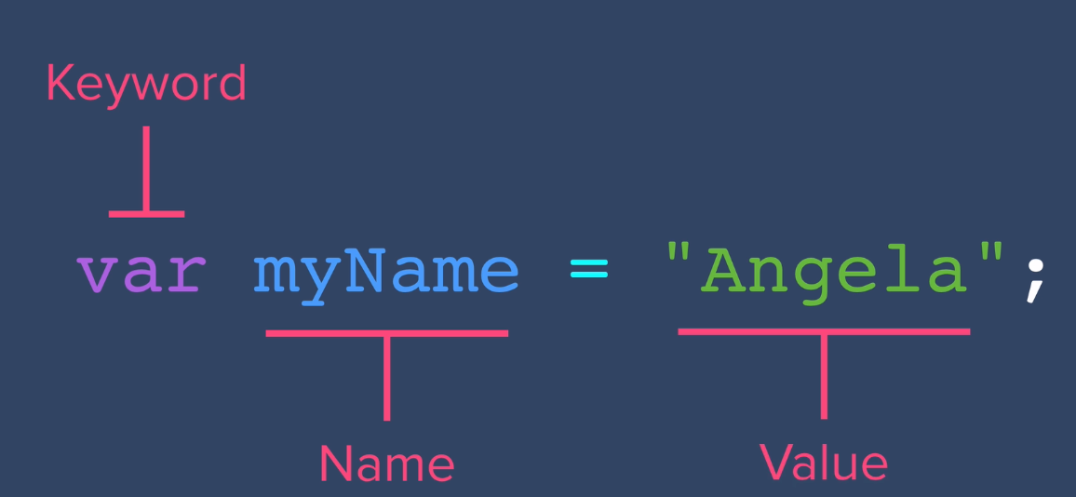

Slide 10
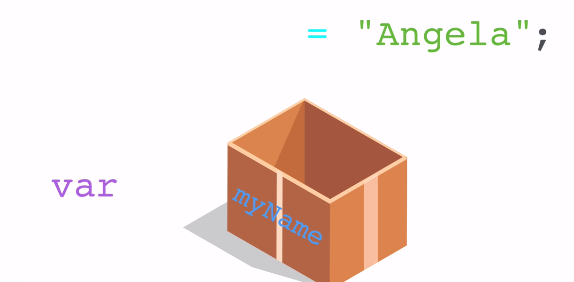
Consider var the keyword define what kind of box , myName is name given to the box and the content in side is value “Angela”

Slide 11
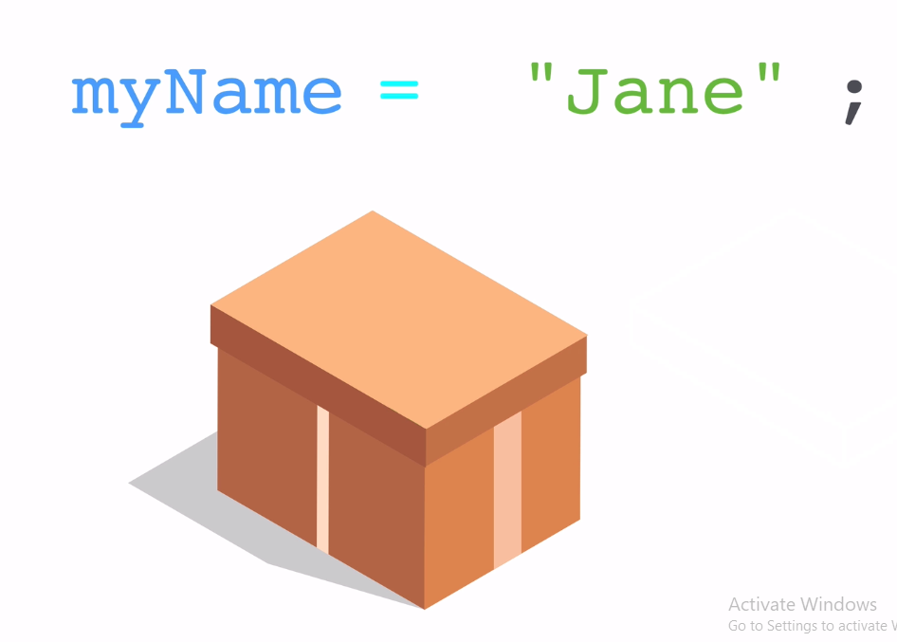

Slide 12
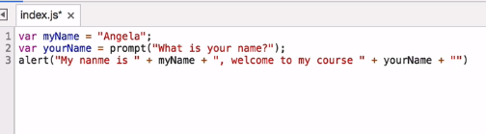
Write a javascript code to take username using prompt and display a alert saying “hi (username ) i am (yourname)”

Slide 13
Javascript Variables Exercise
Given the existing code below, can you write some code so that their values are switched around?
var a = "3";
var b = "8";
So that the variable a holds the value "8".
And the variable b holds the value "3".
When the code is run, it should output:
a is 8
b is 3
Do NOT change any of the existing code.
You are NOT allowed to type any numbers.
You should NOT redeclare the variables a and b.

Slide 14
